Slide 1
Population Genetics in a nutshell: Part II
Institute of Zoology,
Chinese Academy of Sciences, Beijing, China
Dec 2018
University of Science and Technology of China

Slide 2
Let’s start with a team of 2
(Team based learning)
Can you retake seats among yourself and seat with someone you don’t know.
Can you take 2-3 minutes to get to introduce to your friend: who you are.

Slide 3
A quick overview of what we have covered previously
1) The history of population genetics: Darwin, the genetic basis of inheritance, the discovery and rediscovery of Mendelian genetics. The conflict between Biometricians and Mendelian geneticists, the rise of population genetics through the efforts of R.A. Fisher, The three founders of Population Genetics
2) Key concepts in Population genetics and HWE: The scope of population genetics, the concept of HWE, assumptions of HWE, How to test for HWE
3) Natural selection and deterministic theory: Viability selection, how to model natural selection when population size is very large (i.e. deterministic theory), Fundamental theory of natural selection
4) Finite populations and the Wright Fisher model: the concept of WF model (random sampling, i.e. multinomial sampling), genetic drift, the long term fate of an allele, fixation probability, time to fixation, the effective population size.

Slide 4
2.4 Mutation, measures of variability, mutation drift balance, Molecular Clock

Slide 5
Types of mutations
Substitution: change in one DNA base pair from one base to another.
Insertion: changes the number of DNA bases in a gene by adding a piece of DNA. As a result, the protein made by the gene may not function properly.
Deletion: changes the number of DNA bases by removing a piece of DNA. Small deletions may remove one or a few base pairs within a gene, while larger deletions can remove an entire gene or several neighboring genes. The deleted DNA may alter the function of the resulting protein(s).
Duplication: consists of a piece of DNA that is abnormally copied one or more times. This type of mutation may alter the function of the resulting protein.

Slide 6
Mutation rate
Let’s focus on the simple substitutions for now.
There are many possible ways we measure mutation rate. The most classical measurement is probability of mutation per site per generation (often denoted as μ).
The mutation rate for humans is around 1.8*10⁻⁸ per site per generation.

Slide 7
Measurement of variability: θ_{π}
When you sample two genes/sequences from the population and compare their nucleotide sequences, there will be some differences between them. Ideally, more heterogenous populations, you will see higher numbers of differences.
A common measurement is average percentage of differences between two sequences. This is often called θ_{π}= percentage of differences between two sequences.
For human population, this value is around 0.001. Sometimes, we also call this heterozygosity (at the base level).

Slide 8
Mutation drift balance
Genetic drift will purge the variation, but mutation will keep introducing mutations, there will be a mutation-drift balance.
Through some non-trivial exercise, we can prove that θ_{π} is approximately 4N_{e}μ where is the θ_{π} is the percentage of difference between sequences (observed). This provides an intrinsic link between observed data (θ_{π}) and population parameters.
The effective population size of humans is on the order of 10⁴ (10,000).

Slide 9
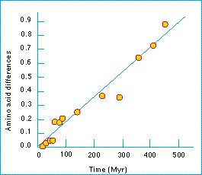
Molecular Clock
The notion of the existence of a
so-called "molecular clock" was first
attributed to Émile Zuckerkandl and
Linus Pauling who, in 1962, noticed
that the number of amino acid
differences in hemoglobin between
different lineages changes roughly
linearly with time, as estimated from
fossil evidence

Slide 10
How to derive the Molecular Clock?
How many mutations are introduced in each generation for a population of size N?
When a mutation is introduced, what’s the frequency of the mutation?
What’s the probability of new mutations being fixed in the population?

Slide 11
2.5 Other forms of natural selection

Slide 12
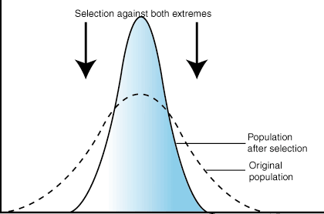
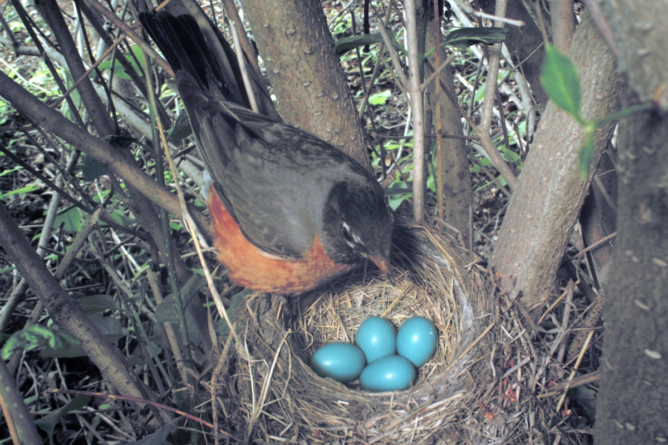
Stabilizing selection
When selective pressures select against the
two extremes of a trait, the population
experiences stabilizing selection.

Slide 13
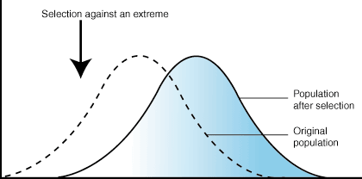
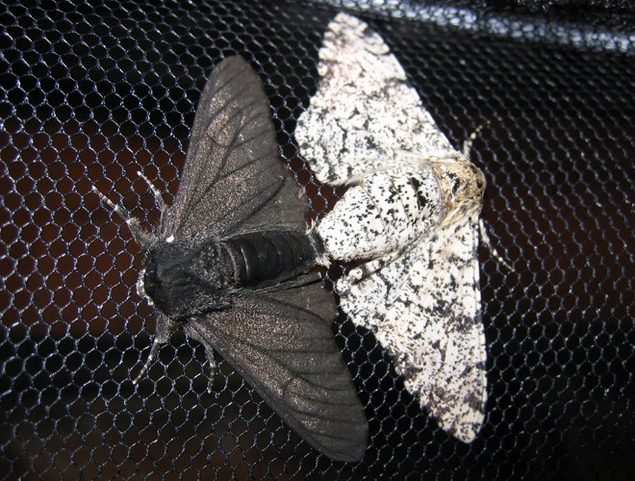
Directional selection
In directional selection, one extreme of the
trait distribution experiences selection against
it. The result is that the population's trait
distribution shifts toward the other extreme.

Slide 14
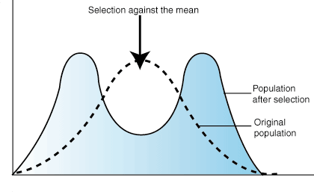
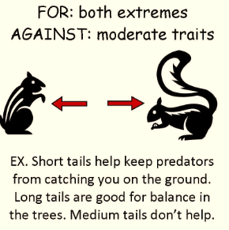
Diversifying (Disruptive) selection
In disruptive selection, selection
pressures act against individuals in the
middle of the trait distribution. The result
is a bimodal, or two-peaked,

Slide 15
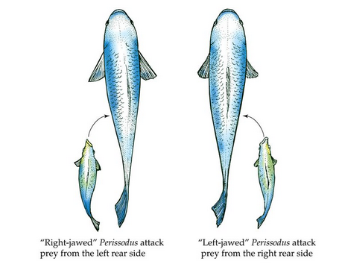
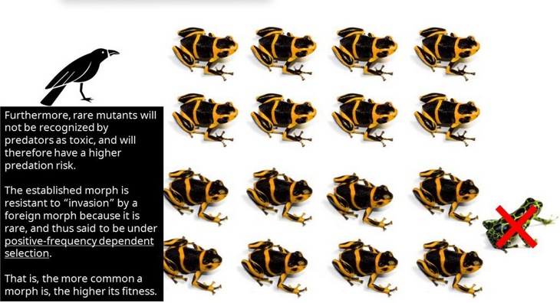
Frequency dependent selection
Frequency-dependent Selection: selection favors phenotypes that are either common (positive frequency-dependent selection) or rare (negative frequency-dependent selection).

Slide 16
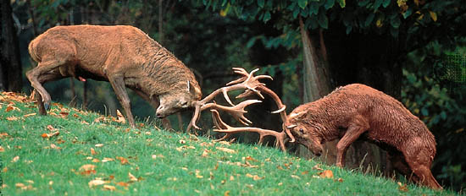
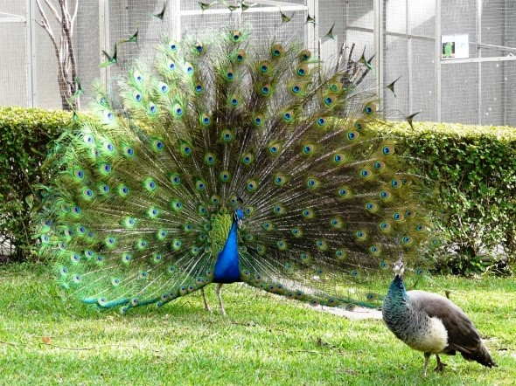
Sexual selection
The selection pressures on males and females to obtain matings is known as sexual selection.
Sexual selection takes two major forms: intersexual selection (also known as ‘mate choice’ or ‘female choice’) in which males compete with each other to be chosen by females; and intrasexual selection (also known as ‘male–male competition’) in which members of the less limited sex (typically males) compete aggressively among themselves for access to the limiting sex.

Slide 17
2.6 Recombination, linkage disequilibrium, genome wide association studies

Slide 18
Recombination and statistical association
Mutation always arises in a genetic background, where association between alleles
are very strong. Recombination on the other hand, will break down the association.
The more distance the two markers, the faster the decay of the correlation.

Slide 19
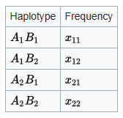
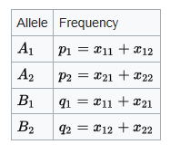
Linkage disequilibrium (LD)
LD: non-random association of alleles at different loci in a given population
D=f(A₁B₁)- f(A₁)*f(B₁), in other words, D=x₁₁-p₁*q₁
Exercise: to show D=x₁₁*x₂₂-x₁₂*x₂₁

Slide 20
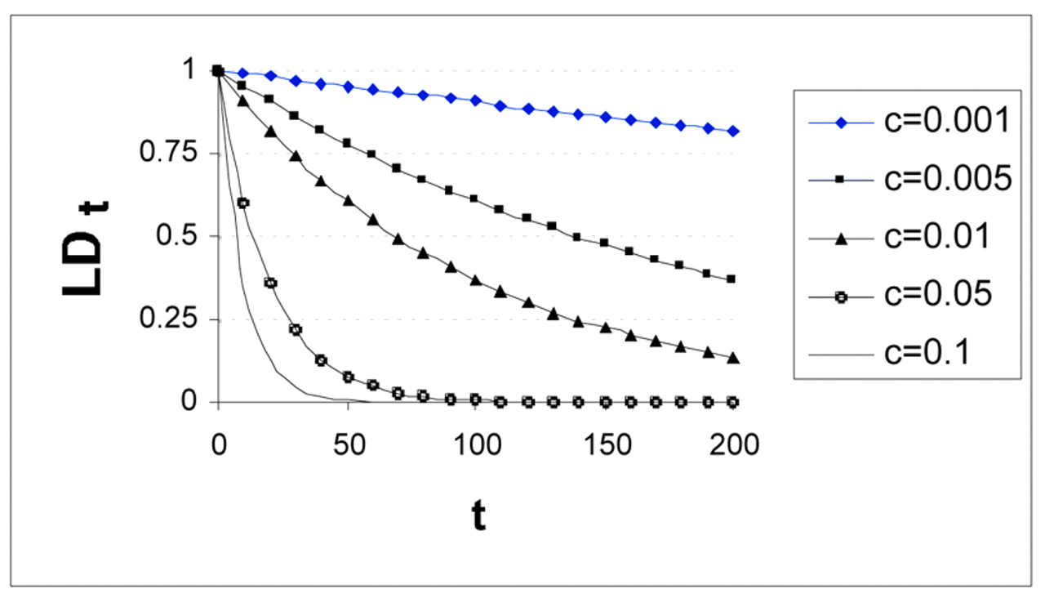
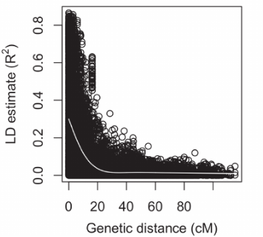
Long term fate of LD
With time
x₁₁’=x₁₁ - r(x₁₁*x₂₂-x₁₂*x₂₁)=x₁₁ - r*D
Likewise, x₁₂’=x₁₂ +r*D, x₂₁’=x₂₁+r*D, x₂₂’=x₂₂-r*D
So, D’=(1-r)D
D will exponentially decay from generation to generation.
LD is weaker for distant markers.
With distance (r)

Slide 21
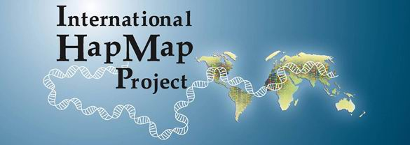
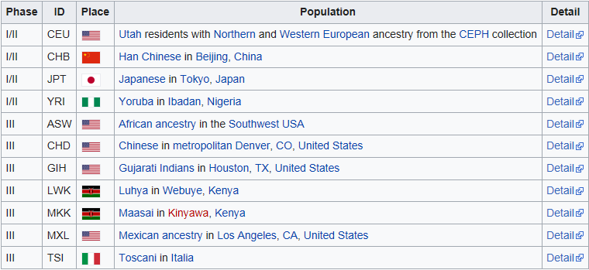
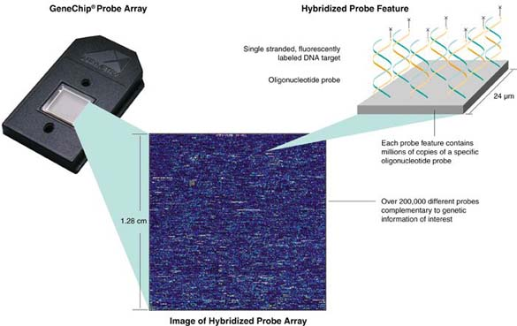
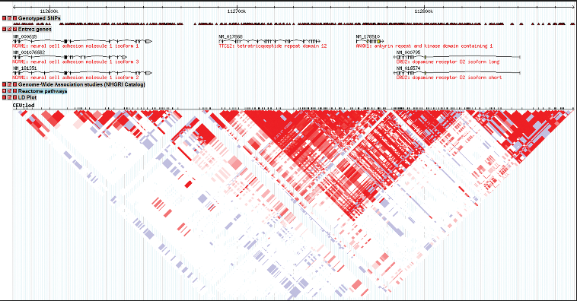
Hapmap project and recombination hotspots
Started on October 27 to 29, 2002-
Phase I: 27 October 2005
Phase 2: October 2007
Phase 3: spring 2009

Slide 22
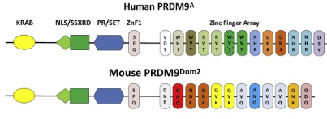
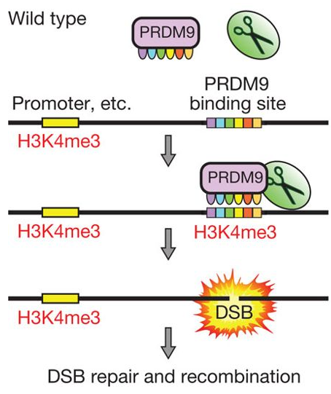
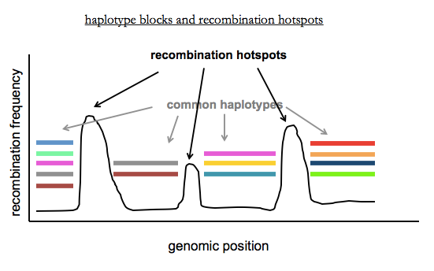
Prdm9 and the recombination hotspot
PR domain zinc finger protein 9 is a protein that in humans is encoded
by the Prdm9 gene. PRDM9 is responsible for positioning recombination
hotspots during meiosis by binding a DNA sequence motif encoded in
its zinc finger domain

Slide 23
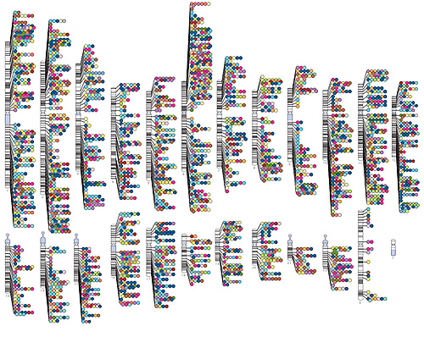
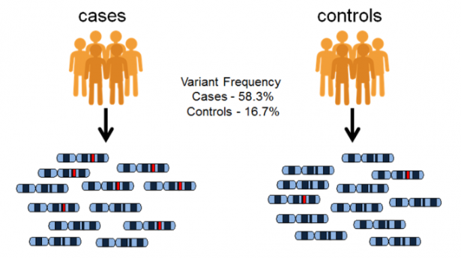
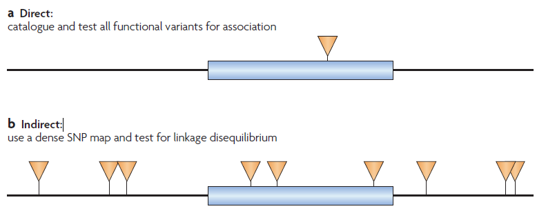
Genome wide association studies
As of 2017-12-11, the GWAS Catalog contains 3233
publications and 55707 unique SNP-trait associations.
GWAS Catalog data is currently mapped to Genome
Assembly GRCh38.p10 and dbSNP Build 150.
https://www.ebi.ac.uk/gwas/

Slide 24
Key points
1) LD between two markers will decrease as recombination breaks down the association between them.
2) LD tends to decrease as the distance between two markers increases.

Slide 25
2.7 Later part of the 20th century for Population Genetics

Slide 26
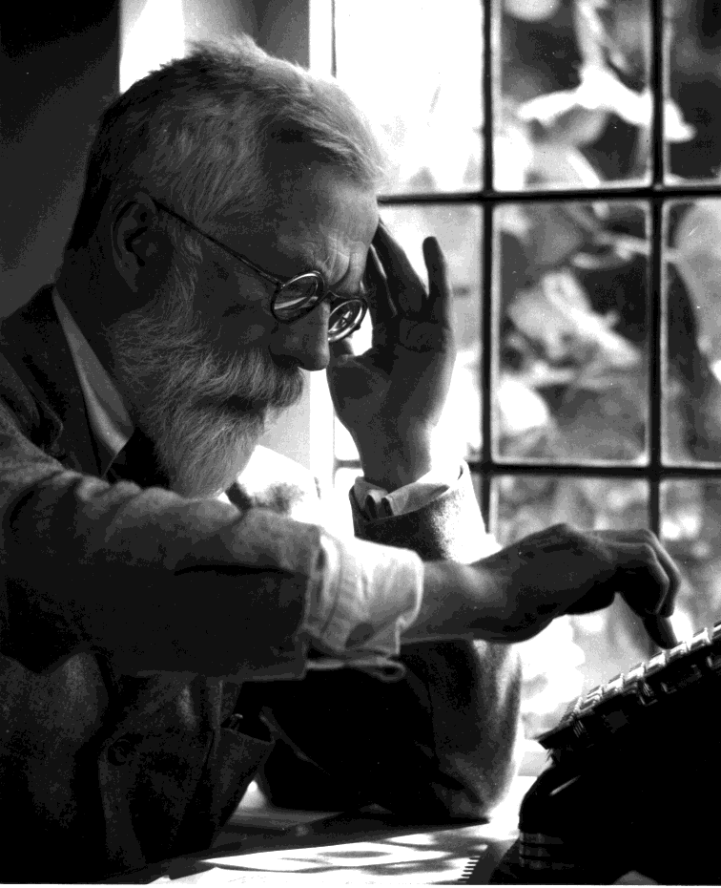
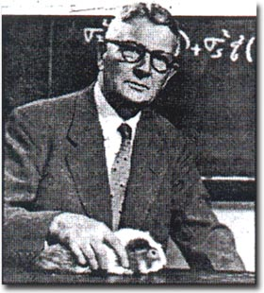
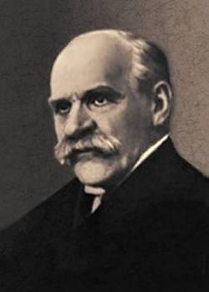
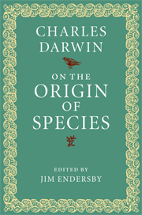
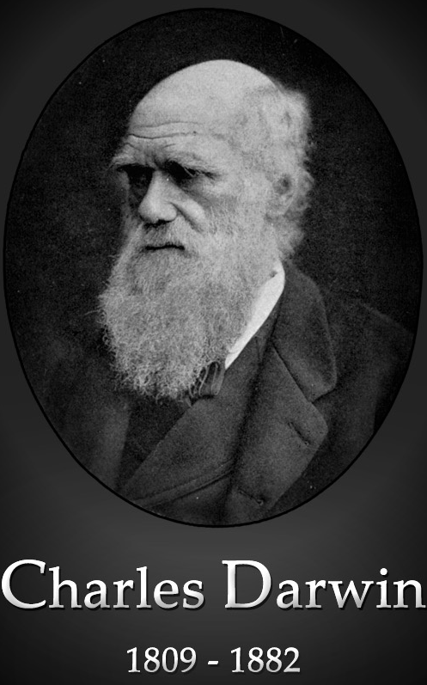
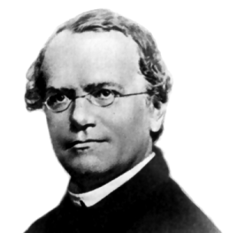
Modern synthesis
R.A Fisher Sewall Wright JBS Haldane
Systematics
Genetics
Ecology
1866
1900
Modern Synthesis
1936-1947
1859
1918
Re-discovery of Mendel law
Morphology
Paleontology
Botany

Slide 27
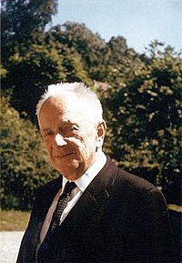
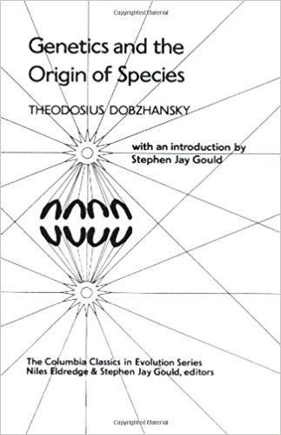
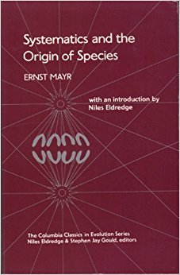
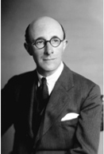
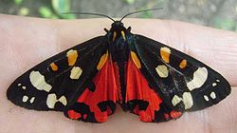
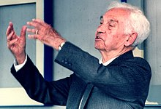
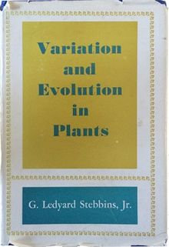
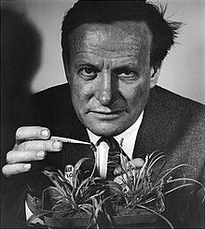
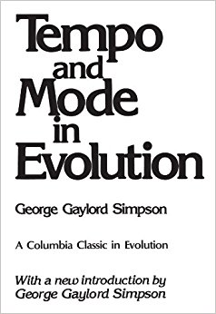
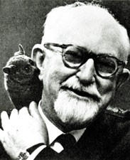
Synthetic theory of evolution (Neo-Darwinism).
Establish natural selection as a dominant
force of evolution (most of the times, the only
mechanism,they are often called pan-selectionist)
Theodosius Dobzhansky, Genetics
1900-1975
Ernst Myer, systematics
1904-2005
Genetics
Systematics
Ecology
E.B Ford, Ecological Genetics
1901-1988
Modern Synthesis
1936-1947
Paleontology
Morphology
George Stebbins, Plant biology
1906-2000
Botany
George Simpson, Fossil record
(1902-1984)

Slide 28
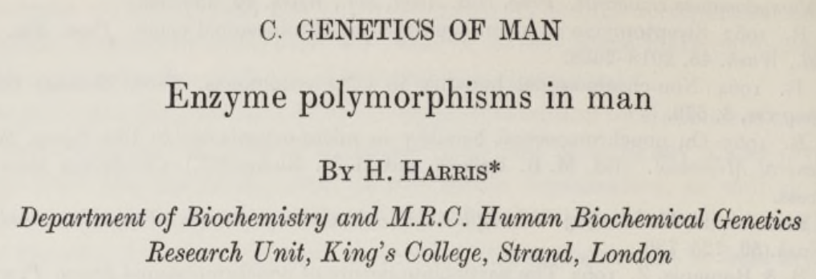
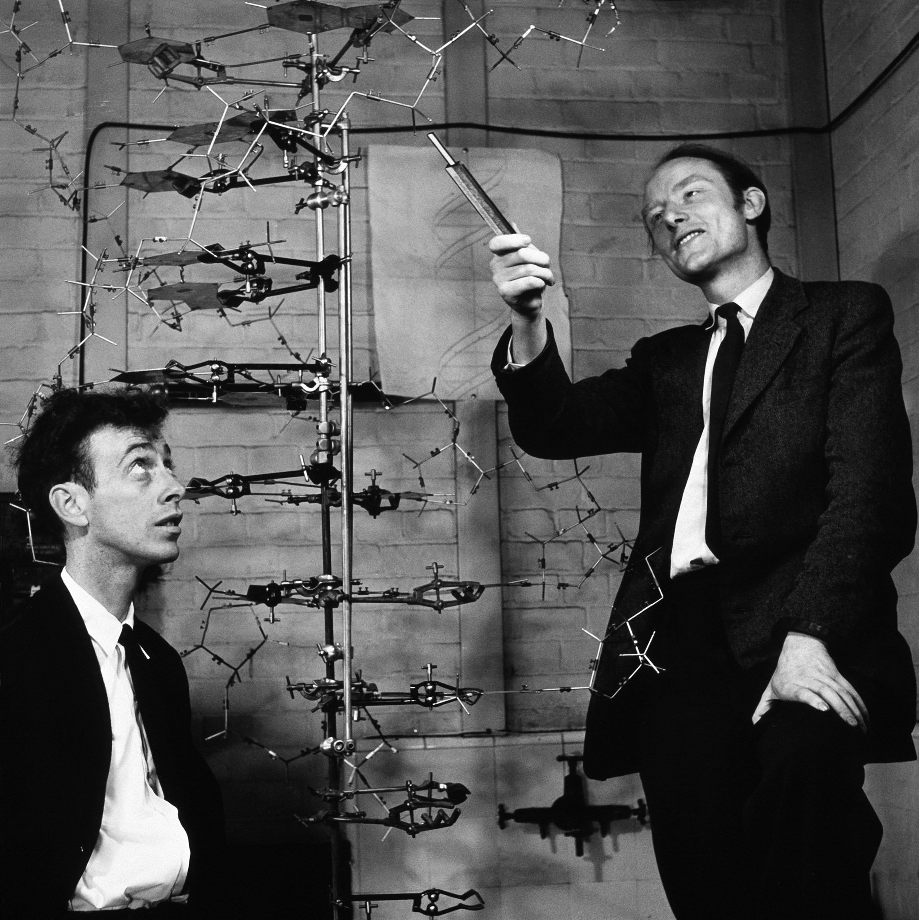
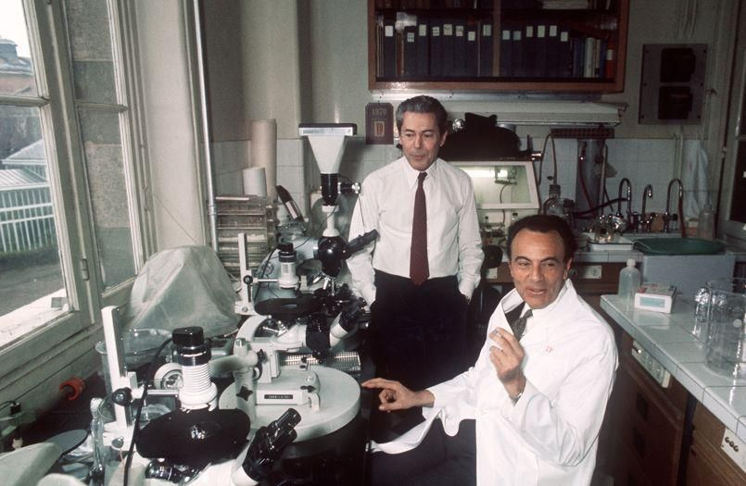
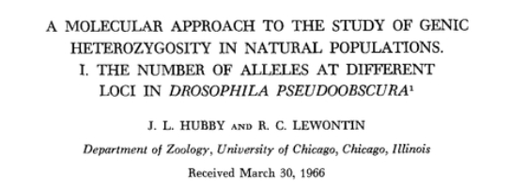
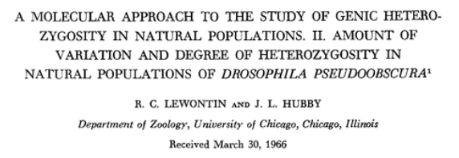
The rise of the molecular biology and seminal work in 1966
1953, Watson and Crick
DNA structure
1961, Jacques Monod and François Jacob
Transcription, mRNA

Slide 29
Molecular evolution and the rise of neutral theory
Variation is pervasive, what maintains this polymorphism?
How do we transform within population polymorphism to between species divergence?

Slide 30
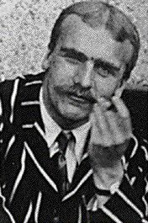
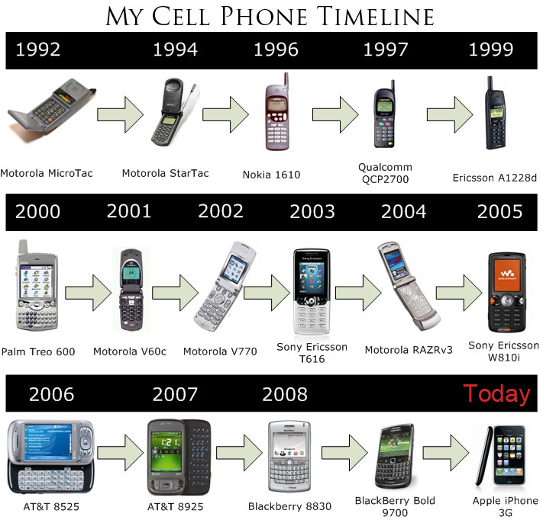
The cost of evolution
The selective death that must occur for a gene to be substituted was called the cost of selection by the biologist J.B.S. Haldane. The cost of selection places an upper limit on the rate of evolution.

Slide 31
The cost of evolution
Example: Let’s say a population of size 10,000 with 100 A and 9, 900 a. If natural selection is really strong, in the next generation, A is almost fixed in the population (e.g. 9,900 A and 100a).
In this scenario, all the A allele has produce on average 99 “offsprings” and 9,900 has to mostly die.
Most of the species cannot sustain this speed of evolution. In other words, selective turnover cannot be too high.

Slide 32
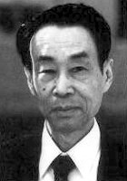
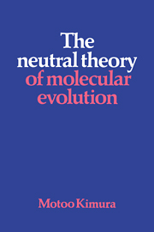
Evolutionary neutral theory
1) The rate of evolution is very fast. One substitution every 2 years.
2) if selection is driving the selective substitution, the cost of the evolution is simply too high.
2) Neutral theory says, most of the differences between species and polymorphism segregating within populations are evolutionarily neutral and driven by genetic drift.
The evolution
neutral theory
Motoo Kimura

Slide 33
The significance of the neutral theory
Articulated the first principle transforming within population polymorphism (micro) to between species differences (macro). This provides a powerful system integrating micro/macro level evolution.
It constructed a powerful null model for the whole field of evolutionary biology. The null model removed the very anthropomorphic side of natural selection.
The neutral theory provides powerful basis for more theoretical studies in the coming years (next section).

Slide 34


Coalescent theory
John Kingman
Prof of Mathematics
University of Cambridge
1939-

Slide 35
Exercise in the lab
A population with N individuals (2N genes) evolving under the WF model. If we randomly take two genes from the current population, what is the probability that they will share a common ancestor in the previous generation?

Slide 36
If we did the exercise correctly
1) The probability of finding a common ancestor is 1/2N.
2) how many generations we will need to find a common ancestor?
3) How this will lead to the differences between the two genes?

Slide 37

When multiple lineages exist, the multi-lineage coalescent will define the gene genealogy of the sample

Slide 38
The link between the gene genealogy and data
Gene genealogy
Variants in sequences

Slide 39

The Site Frequency Spectra
Site frequency spectra
Gene genealogy
Variants in sequences

Slide 40


Selective sweep or the hitchhiking effect
Selective sweep will lead to enrichment of both low and high frequency alleles.

Slide 41


The link between population history (demography) and gene genealogy
G
Demographic history
Data

Slide 42
The power of the coalescent theory
Coalescent theory has deeply transformed population genetics. The probabilistic treatment is simply very beautiful (clean) in many dimensions. The powerful probabilistic treatment allowed many statistical methods to be constructed.
The field has been focused on understand the evolutionary histories of many species in the past few decades including humans. I will use a few examples here. you can read them on the internet.

Slide 43







Population Genetics and Human evolution
Neadnerthals
Admixture between human and Neanderthals
Spatial and temporal
overlap with humans
Svante Paabo
Max Planck Institute for
Evolutionary Anthropology
2010

Slide 44





Denisovans
A small finger bone
with high indigenous DNA
Sister to Neanderthals
Denisovan cave
Denisovan cave in Altai Mountains
Have admixed with people from Melanesian

Slide 45



Further reading

Slide 46






Further reading

Slide 47
Epilogue
I have touched on the classical theory of Population Genetics. There are still a lot to cover for this field.
If you have any further questions. Please feel free to drop me an email at: weiweizhai@ioz.ac.cn
If you are interested in further pursuing this direction, please come to Institute of Zoology, Chinese Academy of Sciences.

